Slide 1
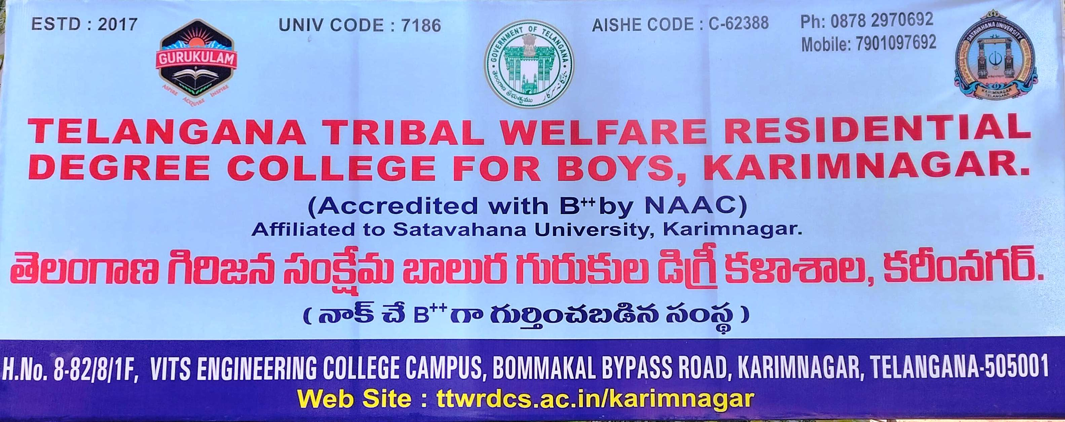
TELANGANA TRIBAL WELFARE RESIDENTIAL
DEGREE COLLEGE FOR BOYS, KARIMNAGAR
(Affiliated to Satavahana University)
Karimnagar, Telangana - 505001
Accredited with B⁺⁺ by NAAC

Slide 2
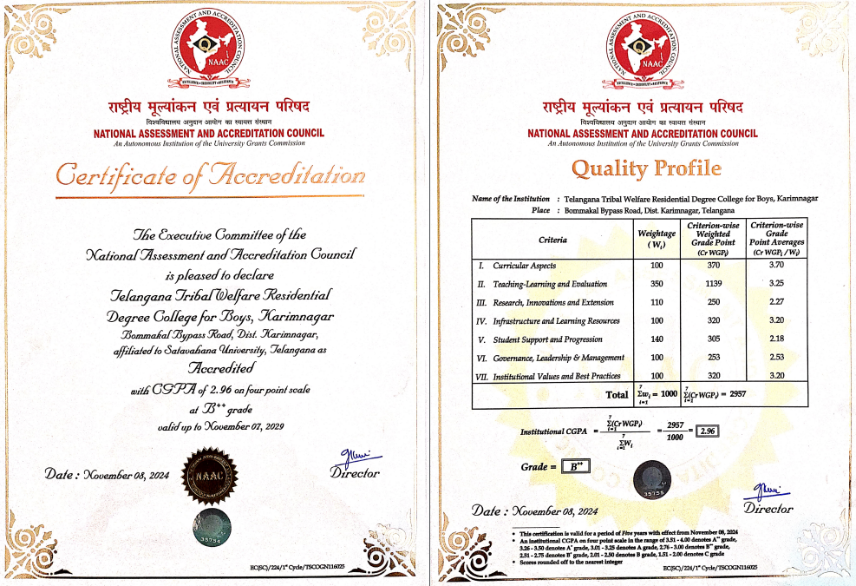
TGTWRDC(B), Karimnagar accredited with B⁺⁺ in the first cycle

Slide 3
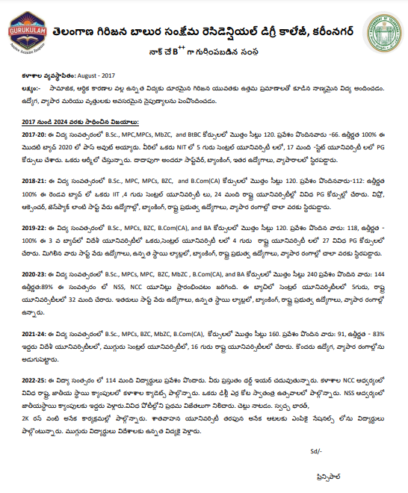
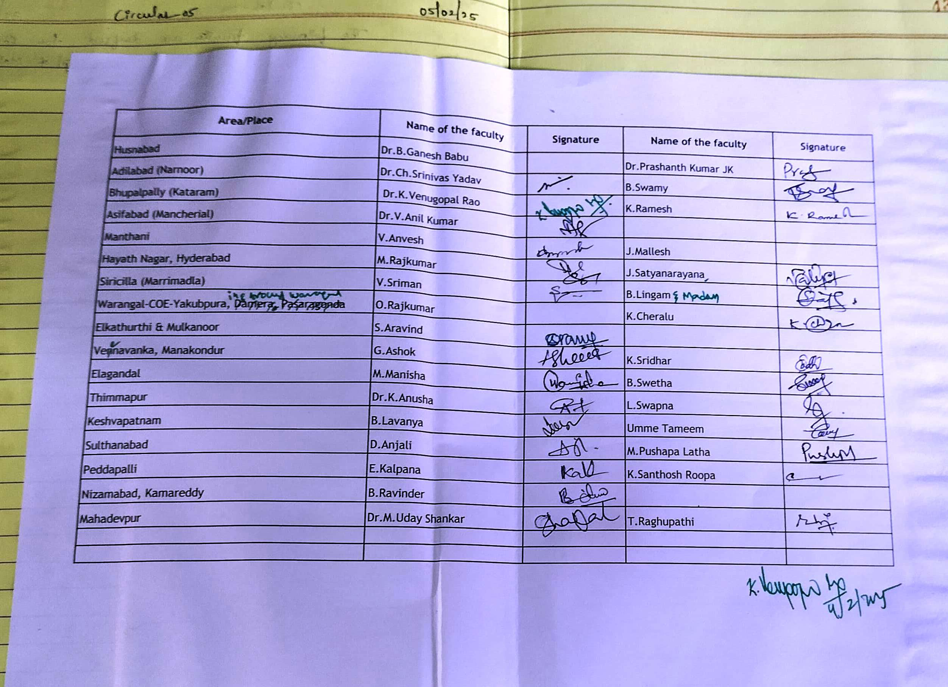
Academic
Action plan & Progress on Admissions-
2025-26

Slide 4
Programmes offered in the college
S.No. | Programme | Combination | Medium | Intake
1. | B.A | B.A. CBCS (Mathematics-Economics-Political Science- Computer Applications) | EM | 40
2. | B. Com. | Computer Applications | EM | 40
3. | B.Sc. | B.Sc. Physical Science (Mathematics- Physics/ DataScience / Economics- Chemistry/Statistics-Computer Science) | EM | 80
4. | B.Sc. | B.Sc. Life Science (botany / Microbiology - Zoology - Chemistry - Computer Science) | EM | 80
Strength Particulars
Programme name | Programme Code | Number of seats sanctioned | Number of students admitted from the reserved category
 |  |  | ST | SC | BC | OC | Sports | NCC | PHC | OTHER | TOTAL
BA(E.P.CA) | 352 | 40 | 30 | - | 01 | - | - | - | - | - | 31
B.Com(CA) | 402 | 40 | 18 | 01 | 01 | - | - | - | 01 | 01 | 22
B.Sc life science(BZC) | 445 | 40 | 16 | 01 | - | - | - | - | - | - | 17
B.Sc life science(MZC) | 457 | 40 | 08 | 01 | 01 | - | - | - | - | - | 10
B.Sc physical science(MPCc) | 464 | 40 | 05 | 01 | 01 | 01 | 01 | - | - | - | 09
B.Sc physical science(MStDs) | 468 | 40 | 15 | 01 | 01 | - | - | - | - | 01 | 18
Total |  | 240 | 92 | 05 | 05 | 01 | 01 | - | 01 | 02 | 107
Attendance
Percentage: 85%

Slide 5
Our Students got Placed in Govt. and Private Sectors
S.No. | Name of the student | Program graduated from | Year of graduation | Name of the employer | Pay package INR ( per annum)
1 | Bukya Teja | B.Sc.Mb.Z.C | 2020 | Cognizant | 5,00,004 p.a
2 | Daravath Nanda Nayak | B.Sc.Mb.Z.C | 2020 | Sam Agri | 2,55,060 p.a
3 | Ganji Rajesh | B.Sc.M.P.C | 2020 | S&P Global | 2,40,000 p.a
4 | Goli Rajkumar | B.Sc.M.P.Cs | 2020 | Q&A | 1,24,224 p.a
5 | K.Ravikumar | B.Sc.M.P.C | 2020 | Laurus Labs | 2,0,5000 p.a
6 | P Shiva sagar | B.COM.CA | 2021 | GenPact | 2,40,000 p.a
7 | Jarupula Gangadhar | B.COM.CA | 2021 | Wipro | 2,60,000 p.a
8 | Punnam Tharun Kumar | B.Sc.M.P.Cs | 2021 | Muthoot FIN CORP | 1,56,960 p.a
9 | Manupati Aditya | B.COM.CA | 2021 | Accenture | 2,55,200 p.a
10 | Azmeera Raghupathi | B.Sc.M.P.Cs | 2022 | SBFC | 2,65,000 p.a
11 | Jarupula Rakesh | B.Sc.Mb.Z.C | 2023 | Granules | 2,10,000 p.a
12 | Durgam karthik | B.Sc.Mb.Z.C | 2023 | Dr.Reddy’s Labs | 2,60,000 p.a
13 | Kolipaka Anil | B.Sc.Mb.Z.C | 2023 | Maatrum Technologies | 2,10,119 p.a
14 | Gaddam Ashok | B.A | 2023 | Solis Pharma | 2,16,000 p.a
15 | Eraveni Raju | B.COM.CA | 2023 | FHPL | 2,26,990 p.a
16 | K. Adithya vardhan | B.COM.CA | 2023 | FHPL | 2,52,497 p.a
17 | Sunke Deepak | B.Sc.B.Z.C | 2023 | FHPL | 2,23,176 p.a
18 | Jakkula Santosh | B.Sc.M.P.C | 2023 | FHPL | 2,23,176 p.a
19 | Bukya Kiran | B.Sc.M.P.C | 2023 | Dr.Reddy’s Labs | 2,10,000 p.a
20 | Kaluguri Raviteja | B.Sc.Mb.Z.C | 2023 | Likhitha’s Diagnostics | 1,80,000 p.a
21 | Sriramula sravan kumar | B.A | 2023 | Trent Limited | 94,239 p.a
S.No. | Names of student | Job Secured
1 | Jadhav Rajeshwar | TS POLICE (TSLPRB)
2 | KUMRA BHUJANGA RAO | TS POLICE (TSLPRB)
3 | Atram Aravind | TS POLICE (TSLPRB)
4 | Gudisela Venkataswamy | TS POLICE (TSLPRB)
5 | Katravath Kumar | Indian Navy Coast guard
6 | Maisa Jalandhar | Telangana Genco.

Slide 6
Our Students got Placed in Govt. and Private Sectors
S.No. | Name of the Student | Job Title | Company Name
1. | V.Nikhil Goud | Engineer-Business Development | S.R Automations
2. | CH.Praveen | Executive in entollment department | FHPL
3. | A.Raj kumar | Executive Enrollment | FHPL
4. | B.Lakpathi | Business analyst | Ghost concepts software services pvt. ltd.
5. | E.Raju | Executive Enrollment | FHPL
6. | A.Adthya kumar | Executive Enrollment | FHPL
7. | S.Sriman | Executive Analyst | Ksheman general solutions
8. | D.Ranjith | Executive Analyst | Ksheman general solutions
9. | V.Ganesh | Executive Analyst | FHPL
10. | V.Rajendar | Executive Analyst | FHPL
S.No. | Name of the Student | Job Title | Company Name
11. | Manoj | Executive Analyst | FHPL
12. | D.Karthik | Production mechine operator | Dr. Reddy's laboratory
13. | B.Kiran | Production mechine operator | Dr. Reddy's laboratory
14. | J.Gangadhar | Relationship executive | Wipro
15. | J.Santhosh | Executive Analyst | FHPL
 |  | Data Associate | Genius consultatnts pvt. ltd.
16.
 |  | Executive Analyst | Ksheman company
17.
18. | Deepak | Business Analyst | Ghost concepts software services pvt. ltd.
19. |  | Data Associate | Genius consultants pvt. ltd.
20. |  | Executive Analyst | FHPL

Slide 7
Achievements
S.No. | Name of the Student | Category | Programme | Admission secured in
 |  |  |  | Course (Masters) | University
1 | Maloth Vamshi Krishna | ST | B.Sc.(BtBC)-2017-20 | M.Sc.(Chemistry) | NIT(Surathkal) Karnataka
2 | Ganji Rajesh | BC-B | B.Sc.(MPC)- 2017-20 | MBA(Gen) | Hyderabad Central University
3 | Dharavath Nandha Naik | ST | B.Sc.(MbZC)-2017-20 | M.Sc.Food Science & Technology | Punjab Central University
4 | Ragula Praveen | SC | 2017-20 | MBA(Business Administration) | Pondicherry University
5 | Gajje Vamshi | SC | B.Com(CA)-2018-21 | M.Com(Finance) | Pondicherry University
6 | Gondra Madhukar | BC-D | B.Com(CA)- 2018-21 | MBA(Business Administration) | Hyderabad Central University
7 | Muddham Naveen | SC | B.Com(CA)- 2018-21 | MBA(Business Analytics) | Hyderabad Central University
8 | K.Upender | SC | B.Sc(MPC) | MA(Telugu) | HCU
9 | S.Pranay | SC | B.Sc(MPC) | BFA(Photography) | JNA & FAU
10 | A.Naveen | ST | BA(2019-22) | M.A Telugu | AP Central University
11 | L.Dileep kumar | SC | MPCS -2019-22 | M.A.English | HCU
12 | M.Anudeep | SC | BA(2019-22) | M.A Sociology | Pondicherry University
13 | B.Raghunath | BC-D | B.Com(CA) -2019-22 | MSC international transport trade &logistics | Liverpool John Moores University,(UK)
14 | L.Anilkumar | ST | BZC | MSC CHEMISTRY | IIT Roorkee
15 | Dayala Mahesh | BC | B.Com(CA) -2020-23 | MBA(Business Administration) | Hyderabad Central University
16 | A.Kranthi Kumar | SC | B.Com(CA) -2020-23 | MBA(Business Administration) | Kerala central university
17 | CH.vamshi | BC | MPCs-2020-23 | M.A Telugu | HCU
18 | Akshay kumar | SC | B.A -2020-23 | M.A.Economics | Kerala central university
19 | S.Vinod kumar | SC | B.Com(CA) -2020-23 | M.Com | Kerala central university
List of the Students Secured Admissions in various
Central Universities

Slide 8
List of Students Secured Admissions in various State & Central Universities
S.No. | Name of student | Program Name | Year of graduation | Name of institution joined | Name of program
1 | Maloth VamshiKrishna | BSC(Bt.B.C) | 2020 | NIT Suratkal, Karnataka | MSc. Chemistry
2 | Ragula Praveen | BSC(Bt.B.C) | 2020 | Pondicherry University | Business Administration
3 | Ganji Rajesh | BSC(M.P.C) | 2020 | Hyderabad Central University | MBA
4 | Daravath Nandha Naik | BSC(Mb.Z.C) | 2020 | Central University, PUNJAB (CUET Exam) | MSc. Food Science
5 | Sunarkar Pranay Kumar | BSC(M.P.Cs) | 2020 | University College of Arts and Social Science(Osmania University) | M.A, SOCIOLOGY
6 | Boda Suresh | BSC(M.P.Cs) | 2020 | University College (Kakatiya University) | M.P.Ed.
7 | Bukya Mahender | BSC(Mb.Z.C) | 2020 | Kavitha Memorial PG College | MSc.MICRO BIOLOGY
8 | Vadthya Bansilal | BSC(Mb.Z.C) | 2020 | Osmania University | B.Ed.
9 | B.Krishna Kumar | BSC(M.P.C) | 2020 | Osmania University | MSc. Chemistry
10 | Maisa Jalandhar | BSC(M.P.C) | 2021 | Osmania University | MSc. Chemistry
11 | Gondra Madhukar | B.Com(CA) | 2021 | Hyderabad Central University | MBA
12 | Muddham Naveen | B.Com(CA) | 2021 | Central University,HYDERABAD (HCUT Exam) | MBA (Business Analytics)
13 | Mudumadigela Srihari | BSC(M.P.C) | 2021 | Nizam College (Osmania University) | M.A. ENGLISH
14 | Porandla Saiteja | BSC(M.P.C) | 2021 | University College of Science. (Osmania University) | MSc. APPLIED MATHS
15 | Punnam Tharun Kumar | BSC(M.P.Cs) | 2021 | ARK Degree and PG College (Osmania University) | M.Sc COMPUTER SCIENCE
S.No. | Name of student | Program Name | Year of graduation | Name of institution joined | Name of program
16 | Malothu Hariprasd | B.Com(CA) | 2021 | Government City college Autonomous | M.COM
17 | Kodam Kushakumar | B.Com(CA) | 2021 | University College of Commerce and Buisiness Management kakatiya University | M.COM .F.A
18 | Madupu Sudheer | BSC(M.P.Cs) | 2021 | University P.G College (PalamuruUniversity) | MCA
19 | Uppeti Satish Kumar | BSC(B.Z.C) | 2021 | P.H.R.M.Degree and PG College(O.U) | MSc ZOOLOGY
20 | Chakali Bheemesh | BSC(M.P.C) | 2021 | Osmania University | MSc PHYSICS
21 | Kandi Sandeep Kumar | BSC(M.P.Cs) | 2021 | Osmania University | MSc PHYSICS
22 | Koram Upendra | BSC(M.P.Cs) | 2021 | Osmania University | MSc PHYSICS
23 | Boini Raghunath | B.Com(CA) | 2022 | LIVERPOOL JOHN MOORIES UNIVERSITY.(U.K.) | International Transport Trade and Logistics
24 | Anil Kumar Lavudya | BSC(B.Z.C) | 2022 | IIT, Roorkee | MSc. Chemistry
25 | Marapaka Anudeep | B.A.(SEP) | 2022 | Central University PONDICHERRY | MA. Socialogy
26 | Lolapu Dileep Kumar | BSC(M.P.C) | 2022 | Central university HYDERABAD | MA. English
27 | Nunavath Naveen | BSC(M.P.Cs) | 2022 | University College of Science. (Osmania University) | MSC. APPLIED MATHS
28 | Chidam Rajashekar | BSC(M.P.Cs) | 2022 | University College of Science. Osmania University | MSC. APPLIED MATHS
29 | Rathod srinivas | BSC(M.P.Cs) | 2022 | University College of Science. Osmania University | MSC MATHS WITH COMPUTER SCIENCE
30 | Kelithu Kiran Nayak | BSC(M.P.Cs) | 2022 | Osmania University | PHYSICS

Slide 9
List of Students Secured Admissions in various State & Central Universities
S.No. | Name of student | Program Name | Year of graduation | Name of institution joined | Name of program
31 | Kokkula Venkatashiva | BSC(M.P.Cs) | 2022 | Osmania University | PHYSICS
32 | Renukuntla Bhanukiran | BSC(B.Z.C) | 2022 | Viveka vardhani College of Arts, Commerce Science and PG College | MSc ZOOLOGY
33 | Giravena Abhishek | BSC(B.Z.C) | 2022 | Telangana University | MSc.BOTANY
34 | Atram Manoj | BSC(M.P.Cs) | 2022 | Vaagdevi College of Physical Education | B.Ped
35 | Banavath Pavan | B.Com(CA) | 2022 | Vishwa Vishwani Institute of Systems and Management | MBA
36 | Salpala Kiran | B.Com(CA) | 2022 | Vishwa Vishwani Institute of Systems and Management | MBA
37 | Lavudya Shekhar | B.Com(CA) | 2022 | University College of Commerce and Business Management Satavahana University | M.COM
38 | Are Anil | B.Com(CA) | 2022 | Nizam College Osmania University | M.COM
39 | Bonthala Laxman Kumar | BSC(M.P.Cs) | 2022 | Vignana Bharathi Institute of Technology | MBA
40 | Dayala.Mahesh | B.Com(CA) | 2023 | Central university HYDERABAD | MBA
41 | Abbaraveni Kranthi Kumar | B.Com(CA) | 2023 | Central University,KERALA | MBA
42 | Balka Akshay Kumar | B.A.(SEP) | 2023 | Central University, KERALA | MA. Economics
43 | S.Vinod Kumar | B.Com(CA) | 2023 | Central University,KERALA | M.Com
44 | Ch.Vamshi | BSC(M.P.Cs) | 2023 | Central university HYDERABAD | MA. Telugu
45 | Arramshetty Sandeep | BSC(M.P.Cs) | 2023 | AURORA UNIVERSITY | MCA
S.No. | Name of student | Program Name | Year of graduation | Name of institution joined | Name of program
46 | Gugulavath Maruthi | BSC(M.P.Cs) | 2023 | University PG College Godavari khani, Shatavahana University | Engineering Physics and Instrumentation
47 | Mesram Shambhu | BSC(M.P.Cs) | 2023 | University College of Science Mahatma Gandhi University | MSc. PHYSICS
48 | Athram Manoj | BSC(M.P.Cs) | 2023 | University College of Science Mahatma Gandhi University | MSc. PHYSICS
49 | Kottepally Shekhar | BSC(M.P.Cs) | 2023 | University College of Science Mahatma Gandhi University | MSc. PHYSICS
50 | Alluri Arunkumar | B.A.(SEP) | 2023 | Justice Kumarayya College of Law Shatavahana University | LLB
51 | Vanga Ganesh | BSC(M.P.C) | 2023 | University College Kakatiya University | MSc. CHEMISTRY
52 | Durgam Karthik | BSC(Mb.Z.C) | 2023 | MNR Degree and PG College Osmania University | MSc. CHEMISTRY
53 | Sidam Krishna rao | B.A.(SEP) | 2023 | University College of Arts and Science (Satavahana University) | M.A. ECONOMICS
54 | Kanneboina Saikiran | BSC(B.Z.C) | 2023 | University College (Kakatiya University) | MSc. CHEMISTRY
55 | Made AnanthRao | BSC(B.Z.C) | 2023 | SRR Government Arts and Science College (Sathavahana University) | M.Sc ZOOLOGY
56 | Katukuri Vishnu Vardhan Reddy | B.Com(CA) | 2023 | University College (Kakatiya University) | MA ECONOMICS
57 | Poludasari Vamshi Krishna | B.A.(SEP) | 2023 | Nigama College of Physical Education(Satavahana University) | B.P.Ed.
58 | Arepalli Thilak | B.A.(SEP) | 2023 | University College (Kakatiya University) | M.T.M

Slide 10
List of Students Secured Admissions in various State & Central Universities
S.No. | Name of student | Program Name | Year of graduation | Name of institution joined | Name of program
75 | ARKA ARUN KUMAR | BSC(Mb.Z.C) | 2024 | Kakatiya University | MSc. ZOOLOGY
76 | DOOSA POTHAN KUMAR | BSC(Mb.Z.C) | 2024 | Kakatiya University | MSc. CHEMISTRY
77 | KAMBALA CHANDRAMOULI | BSC(Mb.Z.C) | 2024 |  | MSc. MICROBIOLOGY
78 | KOMPELLY NITHISH | BSC(Mb.Z.C) | 2024 |  | MSc. MICROBIOLOGY
79 | RUDRA VENKATESH | BSC(Mb.Z.C) | 2024 | Telangana University | MSc. CHEMISTRY
80 | ADLA KISHORE | BSC(M.P.Cs) | 2024 | Kakatiya University | MSc. Computer Science
81 | DANDUGULA PRADEEP | BSC(M.P.Cs) | 2024 | Kakatiya University | MSc. Physics
82 | GAINA RAJENDHAR | BSC(M.P.Cs) | 2024 | Osmania University | MSc. Physics
83 | BASHAVENA ARUN KUMAR | B.Com(CA) | 2024 | Osmania University | M.Com
84 | DILEEP KUMAR SINGH | B.Com(CA) | 2024 |  | Masters in U.K.
85 | EDDAGIRI MADHU | B.Com(CA) | 2024 | SRR Govt. P.G College | M.Com
86 | GURRALA SHIVAMANI | B.Com(CA) | 2024 | Satavahana University | MBA
87 | MADE GANESH | B.Com(CA) | 2024 | Satavahana University | MBA
88 | MAGGIDI SAIKRISHNA | B.Com(CA) | 2024 |  | MBA
89 | NITHEESHKUMAR RONTALA | B.Com(CA) | 2024 | Satavahana University | MBA
90 | PAWAR SACHIN | B.Com(CA) | 2024 |  | M.Com
91 | SATHPADI VARSHATH | B.Com(CA) | 2024 |  | Masters in U.K.
S.No. | Name of student | Program Name | Year of graduation | Name of institution joined | Name of program
59 | Matla Rajkumar | B.A.(SEP) | 2023 | Adarsha Law College | LLB
60 | Mudimadugula Boudha chary | BSC(B.Z.C) | 2023 | Jahnavi Degree and PG College(Osmania University) | M.Sc BOTANY
61 | Rasidam Bharath Kumar | B.A.(SEP) | 2023 | Princeton Degree and PG College | M.A ENGLISH
62 | D.Charles Spurgeon | B.A.(SEP) | 2023 | Princeton Degree and PG College | M.A ENGLISH
63 | Ashodha Kalyan | B.A.(SEP) | 2023 | Kakatiya University | M.A ECONOMICS
64 | Kolipaka Anil | BSC(Mb.Z.C) | 2023 | DR.BR.Ambedkar Open University | M.A ENGLISH
65 | Bhukya Anil kumar | BSC(B.Z.C) | 2024 | Osmania University | MSc.CHEMISTRY
66 | Bhukya Tharun | BSC(B.Z.C) | 2024 | Kakatiya University | MSc. ZOOLOGY
67 | Bollaboina Nanaji | BSC(B.Z.C) | 2024 | Kakatiya University | MSc. CHEMISTRY
68 | Chavariya Rahul | BSC(B.Z.C) | 2024 | Nizam college | MSc. CHEMISTRY
68 | Gudelli Naresh | BSC(B.Z.C) | 2024 | Osmania University | MSc. CHEMISTRY
70 | Madavi Palakrao | BSC(B.Z.C) | 2024 |  | MSc.CHEMISTRY
71 | Mandiga Mallesh | BSC(B.Z.C) | 2024 | Kakatiya University | MSc.CHEMISTRY
72 | Mudimadugula Buddagoutham | BSC(B.Z.C) | 2024 |  | MSc.CHEMISTRY
73 | SALPALA KUMAR | BSC(B.Z.C) | 2024 | Telangana University | MSc. ZOOLOGY
74 | ARABOTHU VIGNESH | BSC(Mb.Z.C) | 2024 |  | MSc. ZOOLOGY

Slide 11
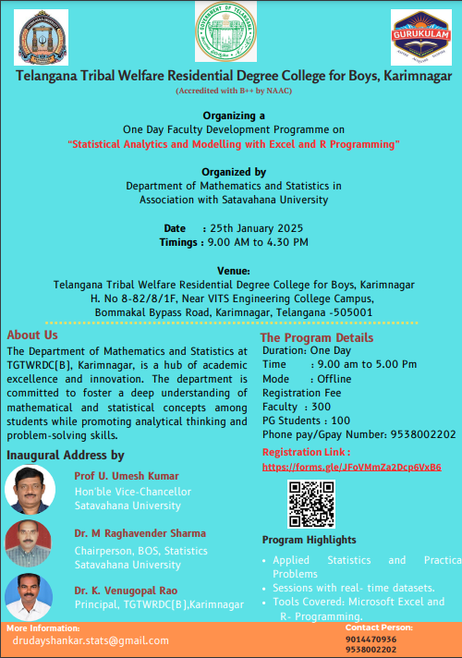
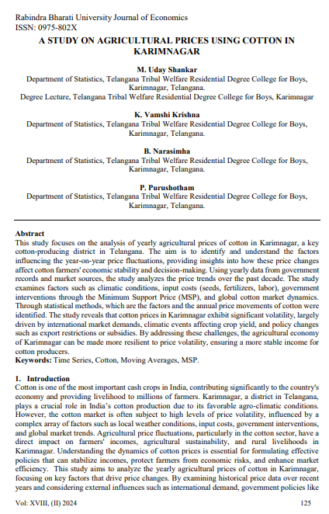
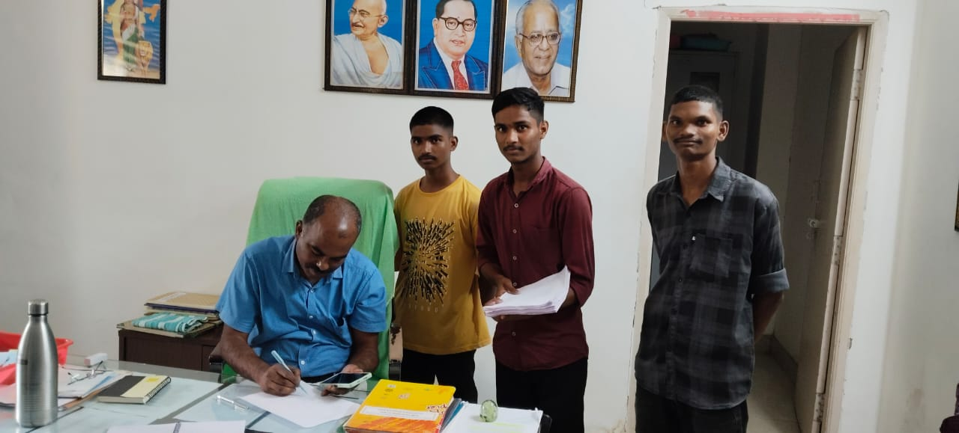
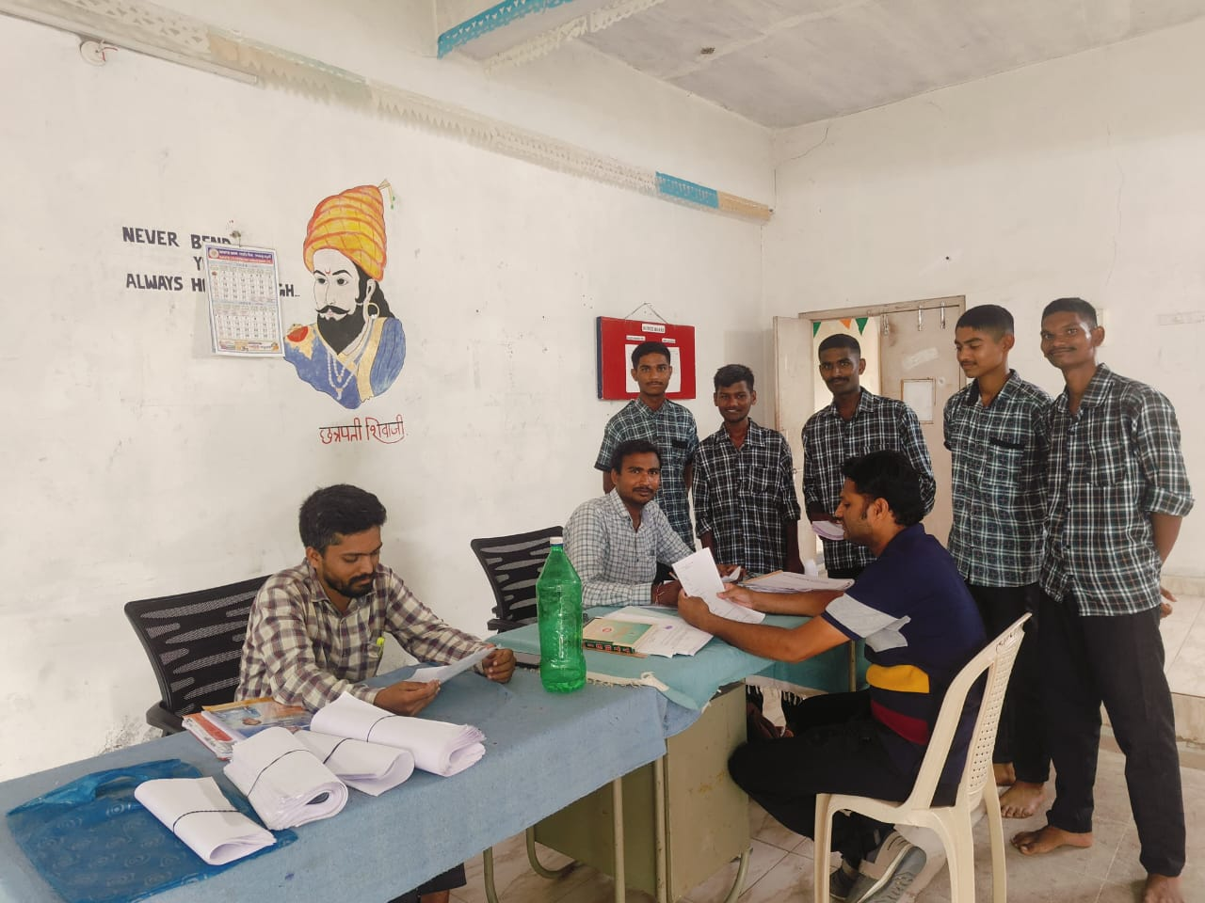
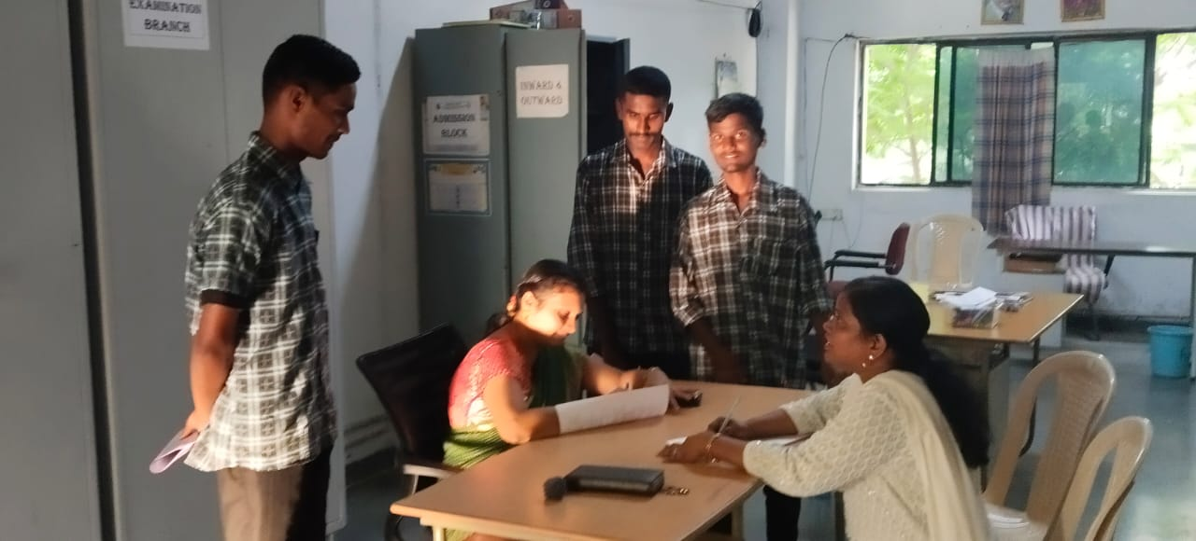
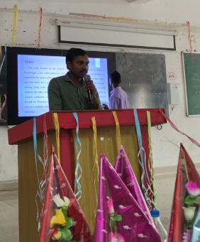
Achievements in the academic year 2024-25
Awareness on Cyber crime –security:
Data collection by MStDs-I year Students from Teaching and Non-Teaching Faculty
A Study on Agricultural Prices using Cotton in Karimnagar.
An Article Jointly published by Students & Faculty of Statistics department in UGC CARE group-I List Journal.
One Day Faculty Development Programme on
“Statistical Analytics and Modelling with Excel and R Programming”

Slide 12
Execution of Academic & Non Academic activities
Preparing AQAR for 2023-24
Common Time Table
Following University Almanac
Club Activities and PG Coaching
Implementations of NAAC Recommendations
Any new initiatives / best practices
Steps may be taken to construct permanent building.
More No. of computers for students’ use as institution has many computer science programs
Competitive examinations, Both state and central, coaching being given to students.
Teaching staff are encouraged to enroll for Ph.D. and also to attend Workshops / Seminars and Conferences.
A few faculty have published research papers in various Scopus and UGC CARE listed journals
To strengthen the placement cell by way of inviting companies for recruitment.
To encourage students to register in DEET( Digital Employment Exchange of
Telangana).
Visiting Students Research Programme 2025 by “tifr” Hyderabad.
This programme offers opportunities for under graduate students to obtain training
in research, thus, helping them to choose a career in computer science.
Department of Statistics is Planning to conduct workshop on
Advanced Computational Statistical Modeling and Data Analysis with R
Administration
Guest Faculty TGTWRDC(B),KARIMNAGAR, Karimnagar (Dist.) Request for Implementation of minimum time scale above 50,000/- on par with other higher educational institutions run by government.
The Guest Faculty have submitted representation through proper channel to the Honorable Secretary, TGTWREIS.

Slide 13
Infrastructure
Building Status : Rented.
The college is presently run in the premises of “Vivekananda Institute of Technology & Science” Bommakal, Karimnagar through a Lease Agreement.
Infrastructure Issues
Requirement : Dual Desks for students in classrooms – 100 to 150.
Usage of Health App Services
Health app: TGTWREIS Health Monitoring System.
Maintenance of Health wellness center/medical equipment and availability of medicines.
Medicines are procured from nearby UPHC, Housing Board Colony, Karimnagar.
Primary basic Hospital checkups are done at UPHC, Advanced and critical Hospital checkups are done at District Hospital, If it is necessary,
students are admitted to Private Hospitals the payments for which are borne by College.
The medical equipment available in the wellness center are BP Operator, Kettle, Pulse oximeter, Thermal gun, Hot & Cold pack, Steamer, Nebulizer, Height scale, Stethoscope, Weighing machine.

Slide 14
Infrastructure
Status of RO, Desktop & Peripherals, amenities, CC cameras, Internet, public address system, Projectors, Xerox, Kitchen Equipment
RO Plants – Working
Desktop & Peripherals – Requirement: 20 Desktop Computers with Advanced Configuration, 15 Headsets and 05 Web cameras for attending online
exams
CC Cameras - 13 CC Cameras have been installed.
Public address system – Sound box, Mike, Amplifier are available.
Projectors – 01 is available and needs to be repaired.
Xerox Machine – 01 is available and is in good condition.
Kitchen Equipment – Requirement: Grinder-01, Stove-02.
Planning
Requirements for NCC.
NCC Uniform amount and Camp activities amount, Refreshment amounts not yet received from 2023-24 and 2024-25.
As per DG-NCC instructions, the uniform amount from 3000/- to 4800/- and refreshment amount from 15/- to 25 /- rupees need to be increased.
For NCC Classes, there is need of marker board with stand , compass(04) and survey map(04).
To organize special days like NCC day, Blood donation camps, Gandhi Jayanthi, Puneeth Sagar abhiyan, swacch barath etc, in NCC unit, allocation of
funds is needed.
Required furniture items like almirah(02),chairs(02) and tables(02) ,Mirror (01) in NCC room.

Slide 15
Availability of Sports Material
SL.NO | NAME OF THE ITEM | QUANTITY
1 | SHUTTLE BADMINTON RACKET | 10
2 | TENNIS CRICKET BALL | 25
3 | VOLLEY BALL (MATCH BALL) | 4
5 | VOLLEYBALL (PRACTISE BALL) | 3
6 | FOOTBALL | 3
7 | CHESS BOARD | 12
SL.NO | NAME OF THE ITEM | QUANTITY
8 | TENNICOIT RINGS | 3
9 | NETBALL | 1
10 | SKIPPING ROPES | 18
11 | MARKING CONES | 12
12 | GYM DUMBELS | 120KG
13 | MEASURING TAPE (50M) | 1
14 | YOGA MATS | 6
Requirements for Sports
SL.NO | DESCRIPTION OF ITEMS | SIZE & VARIATION | QUANTITY
1 | VOLLEYBALL | COSCO SUPER VOLLEY | 8
2 | VOLLEYBALL NET | O | 2
3 | FOOTBALL | O | 6
4 | ANKLES (KHO-KHO) | O | 20
5 | HANDBALL | O | 4
6 | NETBALL | O | 4
7 | CHESS(BOARD AND COINS) | BIG SIZE | 4
8 | CARROM BOARD AND COINS | MEDIUM SIZE | 6
9 | HOCKEY STCIKS | O | 10
10 | HOCKEY BALLS | O | 4
SL.NO | DESCRIPTION OF ITEMS | SIZE & VARIATION | QUANTITY
11 | BADMINTON (RACKETS) | YONEX | 20
12 | BADMINTON (SHUTTLES) | YONEX | 15 BOXES
13 | BADMINTON NET | O | 2
14 | CRICKET BAT (ENGLISH WILLOW) | O | 2
15 | CRICKET BALLS | O | 4 BOXES
16 | CRICKET STUMPS (PLASTIC) | O | 2 SETS
17 | HARD TENNIS BALLS (CRICKET) | O | 100
18 | CRICKET KIT | O | 2
19 | CRICKET PRACTISE BALLS (PLASTIC) | O | 15
20 | CRICKET MAT | HALF | 2
SL.NO | DESCRIPTION OF ITEMS | SIZE & VARIATION | QUANTITY
31 | ANKLE WEIGHTS | 2KGS | 6
32 | SHORT PUT | MEN CATEGORY WEIGHT | 2
33 | DISCUS THROW | MEN CATEGORY WEIGHT | 4
34 | JAVELIN THROW | MEN CATEGORY WEIGHT | 4
35 | JUDO DRESS (JUDO GI) | FREE SIZE | 4
36 | JUDO MAT | O | 1
37 | ELBOW SUPPORTS (KABADDI AND KHO-KHO) | O | 25
38 | WEIGHT MCHINES | O | 2
39 | STADIOMETER | O | 2
40 | FLYING DISC | BIG SIZE | 4
41 | MESURING TAPE | 100M | 1
42 | AGILITY HURDLES | O | 20
43 | AGILITY LADDER | O | 2
44 | MEDICINE BALL | 5KG | 2
45 | GYM BALL | LARGE SIZE | 2

Slide 16
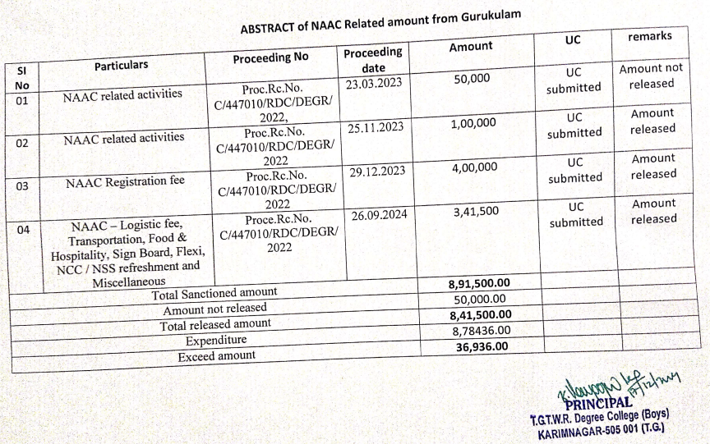
Planning
Accounts
Status of bill & UCs submission for the adjustments of advance, if any.
Almost every Head UC submitted already.
Status of receiving amenities & other
procurements
155 Telugu Academy Books were purchased under CSR.
Attendance of the students & staff and biometric issues, if any
Device stopped by TSTS from December 10th 2024.
If the device is activated, all the students will start marking their bio-metric attendance.
Report on NAAC expenditure

Slide 17
IT
Health Command Centre
Status of receiving amenities & other
procurements
Personal hygiene: conducting health camps regularly, Organizing awareness programs like Cancer awareness program, TB, Malaria(seasonal diseases), Dengue, Sickle cell anaemia etc., fogging for to prevention of mosquitos, Nutritional week. Health education is provided weekly once on Tuesday.
Implementation of the menu as per the guidelines
Seasonal vegetables are not available, only certain vegetables are served as supplied by the contractor.
Status of usage of gov.in mail IDs
Regular usage of govt. mails.
Website updation / social media updates on academics and non-academic achievements & events
Every event organized in the institution is updated in college website as well as on various social media platforms.

Slide 18
Thank You
Principal
Dr. K. Venugopal Rao,
TGTWRDC(B), Karimnagar.

